Slide 1
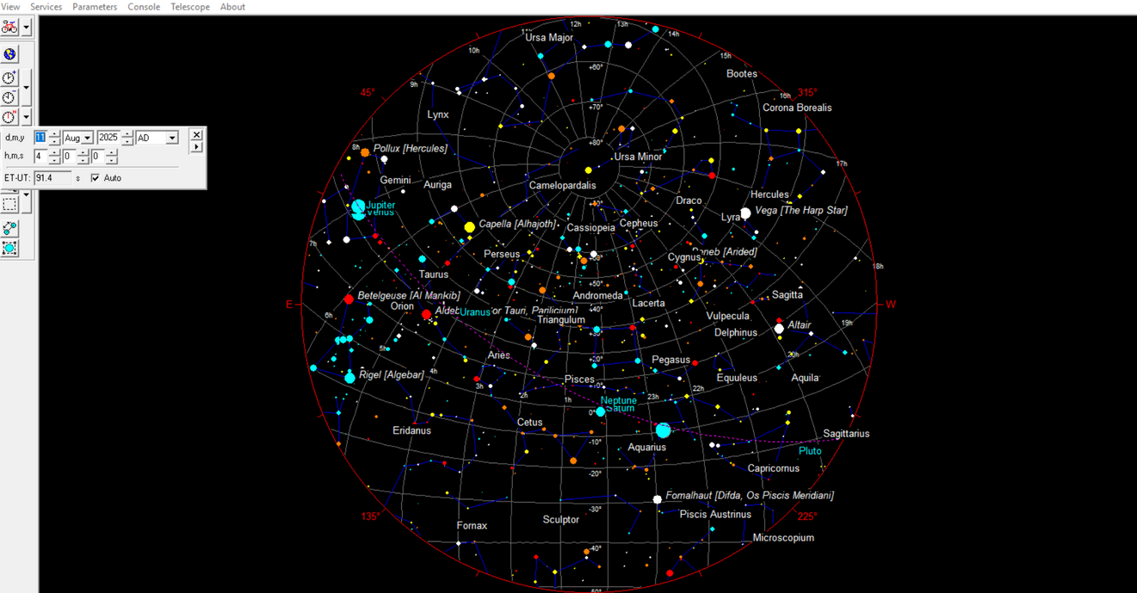

MONTH # 1
HAYKYAN IMMOVABLE CALENDAR
HAYK’S BOON TOMAR
OBSERVATION POINT:
TATEV MONASTERY
GAVAZAN PILLAR
ARMENIA
NAVASARD
2025
Tatev, Armenia
Lat: 39.38° N
Long: 46.26 E
Time Zone: UTC+4
MINTAKA: 98° Azimuth
30 days with the
1h 58m sidereal drift correction
Sidereal Drift from Aug 11, 2025 4:00 (hh:mm)
Navasard Month #1
Lat: 39.38° N
Long: 46.26 E
Time Zone: UTC+4

Slide 2
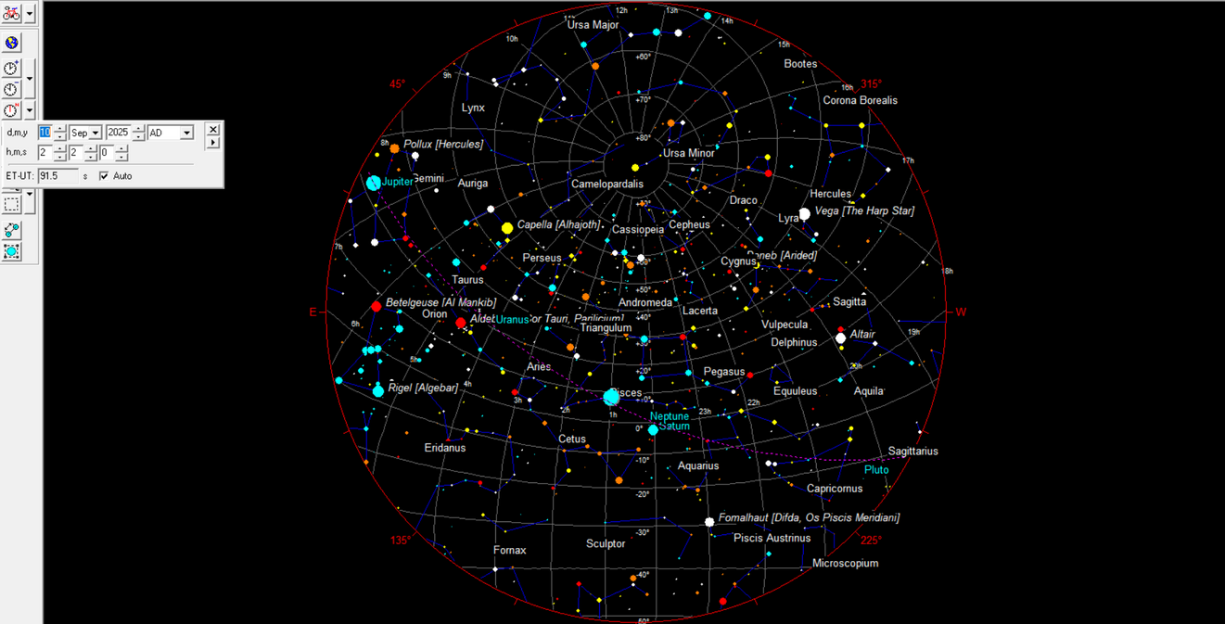
MONTH # 2
HAYKYAN IMMOVABLE CALENDAR
HAYK’S BOON TOMAR
OBSERVATION POINT:
TATEV MONASTERY
GAVAZAN PILLAR
ARMENIA
Tatev, Armenia
Lat: 39.38° N
Long: 46.26 E
Time Zone: UTC+4
MINTAKA: 98° Azimuth
30 days with the
1h 58m sidereal drift correction
Month #2
10 Sep 2025 02:02
Lat: 39.38° N
Long: 46.26 E
Time Zone: UTC+4

Slide 3
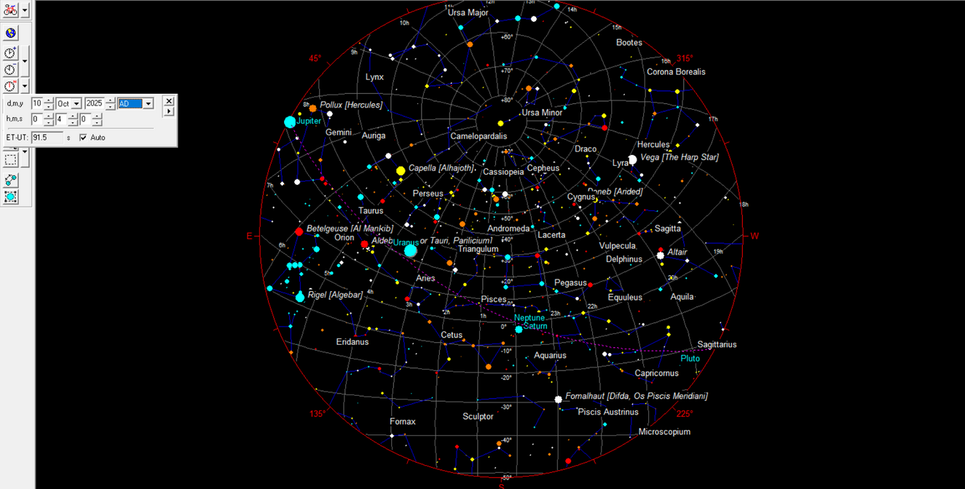
MONTH # 3
HAYKYAN IMMOVABLE CALENDAR
HAYK’S BOON TOMAR
OBSERVATION POINT:
TATEV MONASTERY
GAVAZAN PILLAR
ARMENIA
Tatev, Armenia
Lat: 39.38° N
Long: 46.26 E
Time Zone: UTC+4
MINTAKA: 98° Azimuth
30 days with the
1h 58m sidereal drift correction
Month #3
10 Oct 2025 00:04
Lat: 39.38° N
Long: 46.26 E
Time Zone: UTC+4

Slide 4
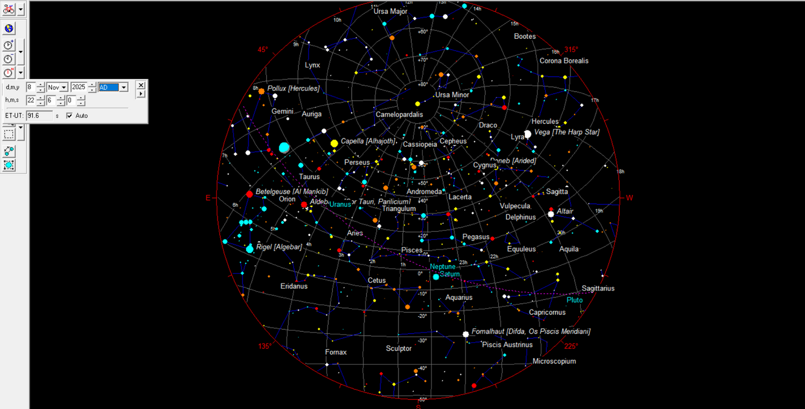
MONTH # 4
HAYKYAN IMMOVABLE CALENDAR
HAYK’S BOON TOMAR
OBSERVATION POINT:
TATEV MONASTERY
GAVAZAN PILLAR
ARMENIA
Tatev, Armenia
Lat: 39.38° N
Long: 46.26 E
Time Zone: UTC+4
MINTAKA: 98° Azimuth
30 days with the
1h 58m sidereal drift correction
Month #4
8 Nov 2025 22:06
Lat: 39.38° N
Long: 46.26 E
Time Zone: UTC+4

Slide 5
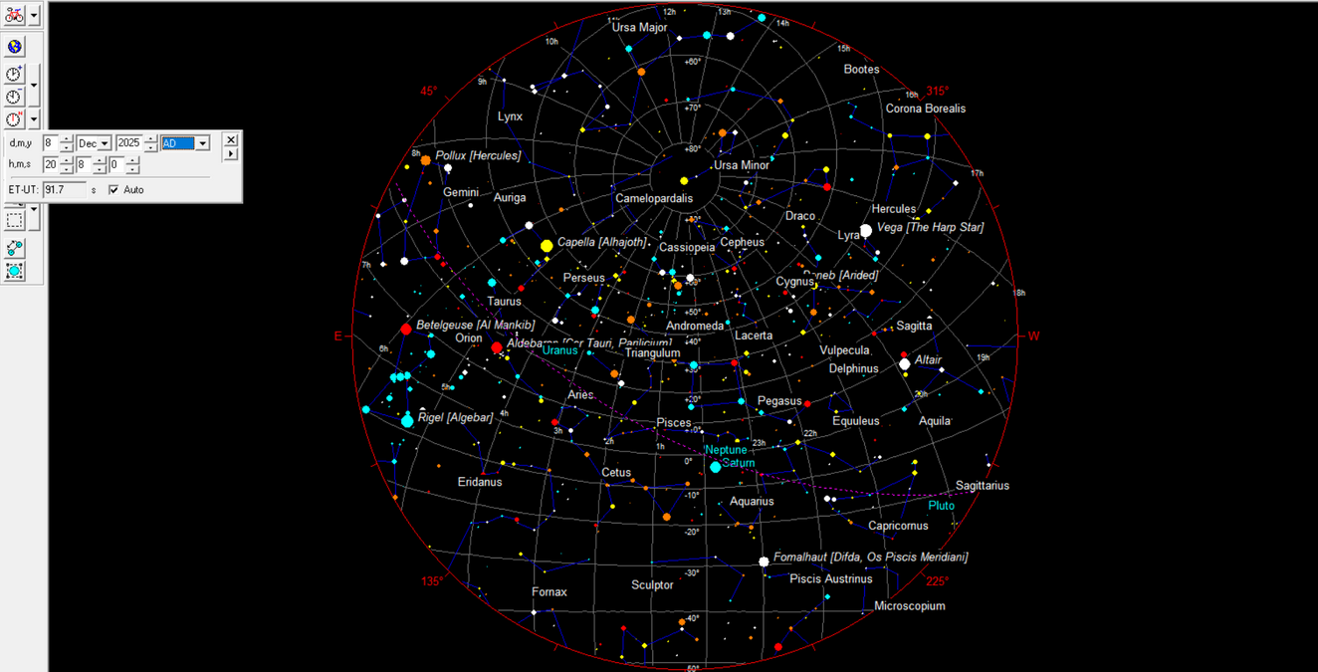
MONTH # 5
HAYKYAN IMMOVABLE CALENDAR
HAYK’S BOON TOMAR
OBSERVATION POINT:
TATEV MONASTERY
GAVAZAN PILLAR
ARMENIA
Tatev, Armenia
Lat: 39.38° N
Long: 46.26 E
Time Zone: UTC+4
MINTAKA: 98° Azimuth
30 days with the
1h 58m sidereal drift correction
Month #5
8 Dec 2025 20:08
Lat: 39.38° N
Long: 46.26 E
Time Zone: UTC+4

Slide 6
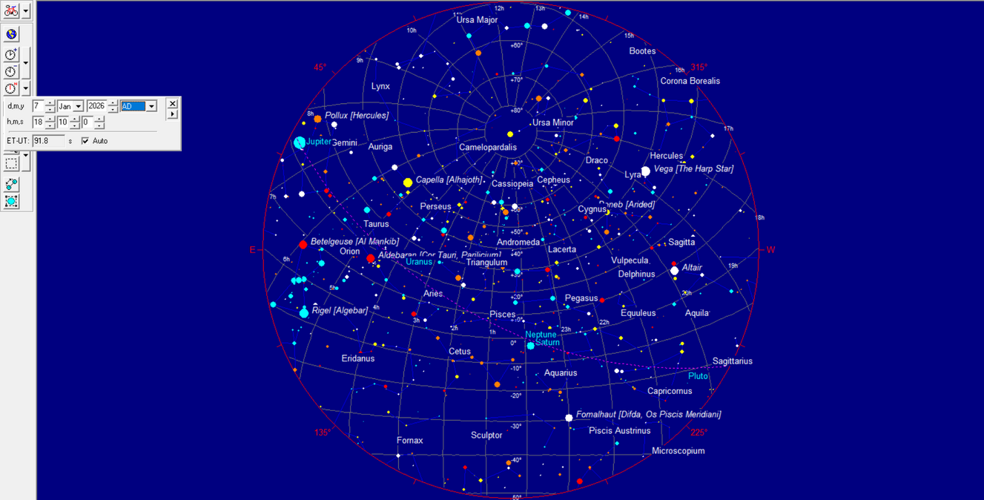
MONTH # 6
HAYKYAN IMMOVABLE CALENDAR
HAYK’S BOON TOMAR
OBSERVATION POINT:
TATEV MONASTERY
GAVAZAN PILLAR
ARMENIA
Tatev, Armenia
Lat: 39.38° N
Long: 46.26 E
Time Zone: UTC+4
MINTAKA: 98° Azimuth
30 days with the
1h 58m sidereal drift correction
Month #6
7 Jan 2026 18:10
Lat: 39.38° N
Long: 46.26 E
Time Zone: UTC+4

Slide 7
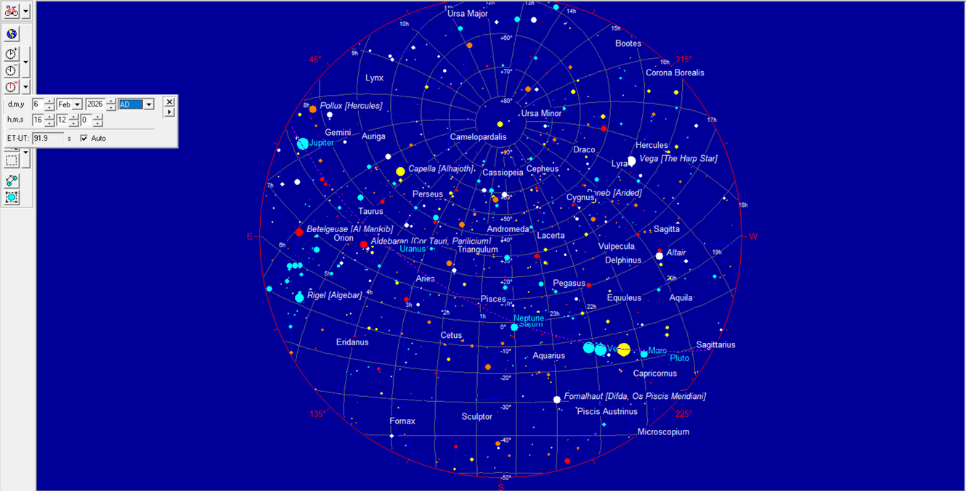
MONTH # 7
HAYKYAN IMMOVABLE CALENDAR
HAYK’S BOON TOMAR
OBSERVATION POINT:
TATEV MONASTERY
GAVAZAN PILLAR
ARMENIA
Tatev, Armenia
Lat: 39.38° N
Long: 46.26 E
Time Zone: UTC+4
MINTAKA: 98° Azimuth
30 days with the
1h 58m sidereal drift correction
Month #7
6 Feb 2026 16:12
Lat: 39.38° N
Long: 46.26 E
Time Zone: UTC+4

Slide 8

MONTH # 8
HAYKYAN IMMOVABLE CALENDAR
HAYK’S BOON TOMAR
OBSERVATION POINT:
TATEV MONASTERY
GAVAZAN PILLAR
ARMENIA
Tatev, Armenia
Lat: 39.38° N
Long: 46.26 E
Time Zone: UTC+4
MINTAKA: 98° Azimuth
30 days with the
1h 58m sidereal drift correction
Month #8
8 Mar 2026 14:14
Lat: 39.38° N
Long: 46.26 E
Time Zone: UTC+4

Slide 9
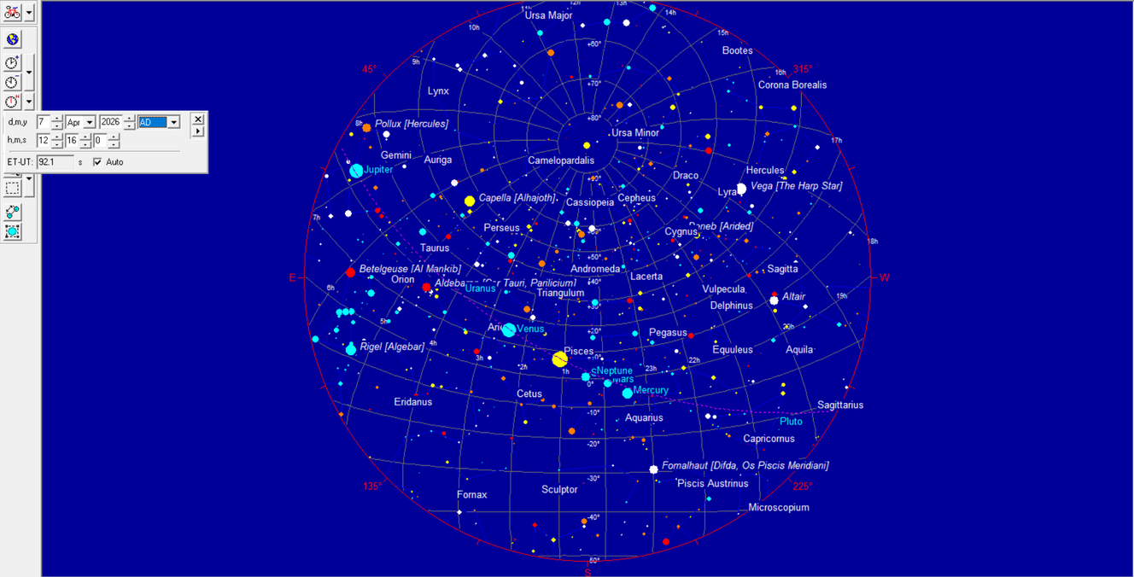
MONTH # 9
HAYKYAN IMMOVABLE CALENDAR
HAYK’S BOON TOMAR
OBSERVATION POINT:
TATEV MONASTERY
GAVAZAN PILLAR
ARMENIA
Tatev, Armenia
Lat: 39.38° N
Long: 46.26 E
Time Zone: UTC+4
MINTAKA: 98° Azimuth
30 days with the
1h 58m sidereal drift correction
Month #9
7 Apr 2026 12:16
Lat: 39.38° N
Long: 46.26 E
Time Zone: UTC+4

Slide 10
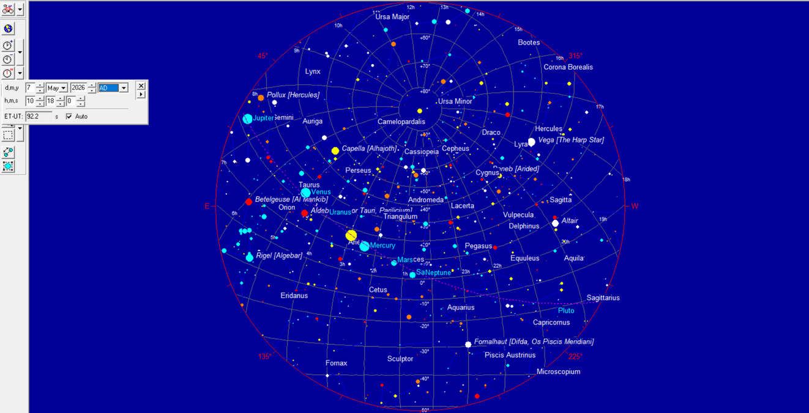
MONTH # 10
HAYKYAN IMMOVABLE CALENDAR
HAYK’S BOON TOMAR
OBSERVATION POINT:
TATEV MONASTERY
GAVAZAN PILLAR
ARMENIA
Tatev, Armenia
Lat: 39.38° N
Long: 46.26 E
Time Zone: UTC+4
MINTAKA: 98° Azimuth
30 days with the
1h 58m sidereal drift correction
Month #10
7 May 2026 10:18
Lat: 39.38° N
Long: 46.26 E
Time Zone: UTC+4

Slide 11

MONTH # 11
HAYKYAN IMMOVABLE CALENDAR
HAYK’S BOON TOMAR
OBSERVATION POINT:
TATEV MONASTERY
GAVAZAN PILLAR
ARMENIA
Tatev, Armenia
Lat: 39.38° N
Long: 46.26 E
Time Zone: UTC+4
MINTAKA: 98° Azimuth
30 days with the
1h 58m sidereal drift correction
Month #11
6 Jun 2026 08:20
Lat: 39.38° N
Long: 46.26 E
Time Zone: UTC+4

Slide 12

MONTH # 12
HAYKYAN IMMOVABLE CALENDAR
HAYK’S BOON TOMAR
OBSERVATION POINT:
TATEV MONASTERY
GAVAZAN PILLAR
ARMENIA
Tatev, Armenia
Lat: 39.38° N
Long: 46.26 E
Time Zone: UTC+4
MINTAKA: 98° Azimuth
30 days with the
1h 58m sidereal drift correction
Month #12
6 Jul 2026 06:22
Lat: 39.38° N
Long: 46.26 E
Time Zone: UTC+4

Slide 13
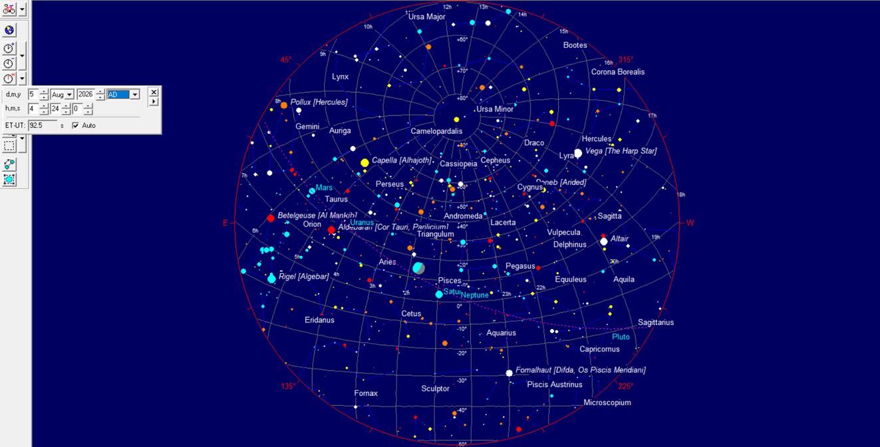
MONTH # 13
HAYKYAN IMMOVABLE CALENDAR
HAYK’S BOON TOMAR
OBSERVATION POINT:
TATEV MONASTERY
GAVAZAN PILLAR
ARMENIA
AVELYATS
2026
Tatev, Armenia
Lat: 39.38° N
Long: 46.26 E
Time Zone: UTC+4
MINTAKA: 98° Azimuth
6 days with the
1h 58m sidereal drift correction
Month #13 AVELYATS
5 Aug 2026 04:24
5.25 EPAGOMENAL DAYS
Lat: 39.38° N
Long: 46.26 E
Time Zone: UTC+4

Slide 14
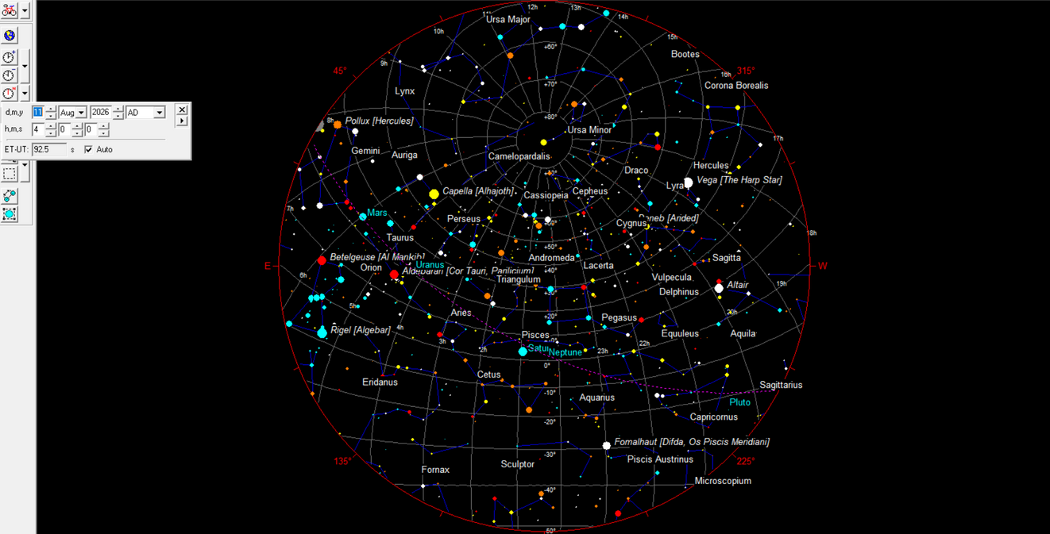
MONTH # 1
HAYKYAN IMMOVABLE CALENDAR
HAYK’S BOON TOMAR
OBSERVATION POINT:
TATEV MONASTERY
GAVAZAN PILLAR
ARMENIA
NAVASARD
2026
Tatev, Armenia
Lat: 39.38° N
Long: 46.26 E
Time Zone: UTC+4
MINTAKA: 98° Azimuth
Start of a new cycle
and new year
Lat: 39.38° N
Long: 46.26 E
Time Zone: UTC+4

Slide 15
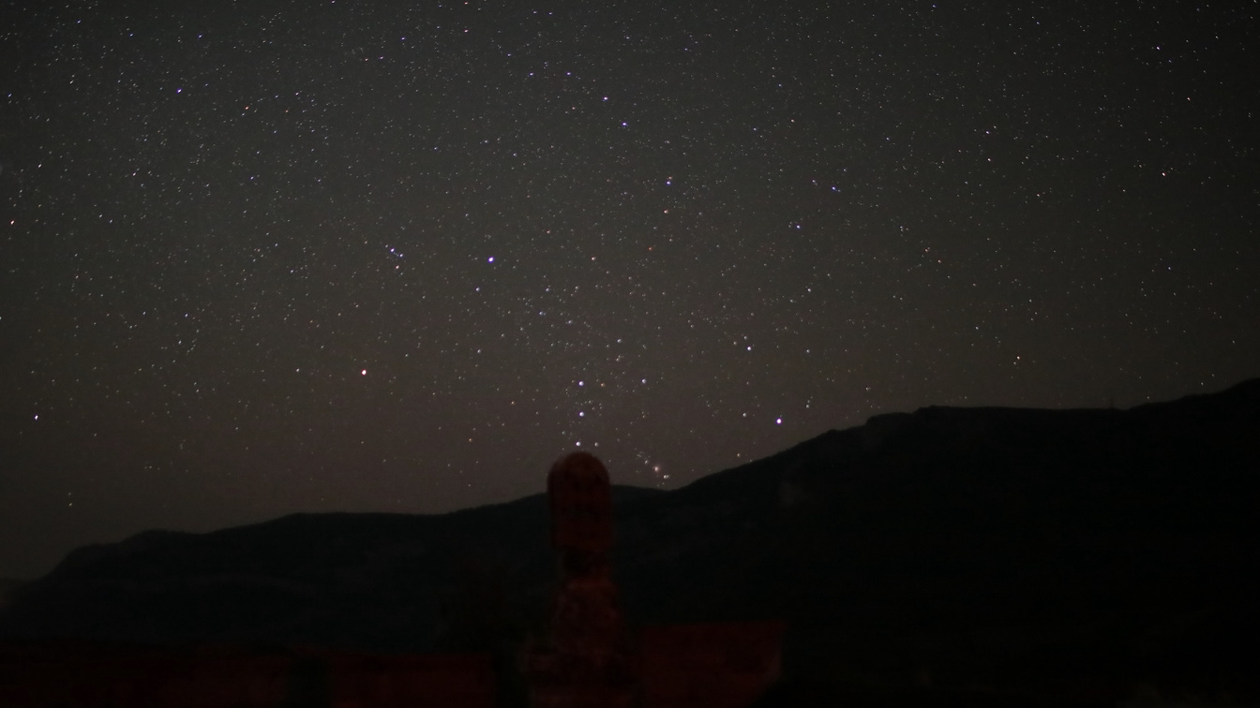
NAVASARD
August 11, 4 AM
Tatev, Armenia
Lat: 39.38° N
Long: 46.26 E
Time Zone: UTC+4

Slide 16
